Slide 1
Closing the Loop with Student Data
Val Torrens | North Kitsap | Leadership WSSDA
Chad Magendanz | Issaquah | Leadership WSSDA
Rich Parker | South Whidbey | WSSDA Cadre
9/1/2011

Slide 2
Washington School Board Standards
Standard 4
Hold school district accountable for meeting student learning expectations by:
Committing to continuous improvement in student achievement at each school and throughout the district.
Evaluating the superintendent on clear and focused expectations.
Measuring student academic progress and needs based on valid and reliable assessments.

Slide 3
The Virtuous Cycle
Evaluation
Assessment
Goal
Setting

Slide 4
Policy Governance vs. Traditional Governance
Notes:
http://www.carvergovernance.com/pg-np.htm

Slide 5
The Problems:
Data is collected, but not used effectively.
We measure the means, not progress towards the goals.
Collecting data has unintended consequences.
Data

Slide 6
Data is never perfect!
Know the limitations of your data.
Know the unintended consequences of your data measurement.

Slide 7
Deliverables
Monitoring Reports
District Scorecards
Superintendent Evaluations

Slide 8
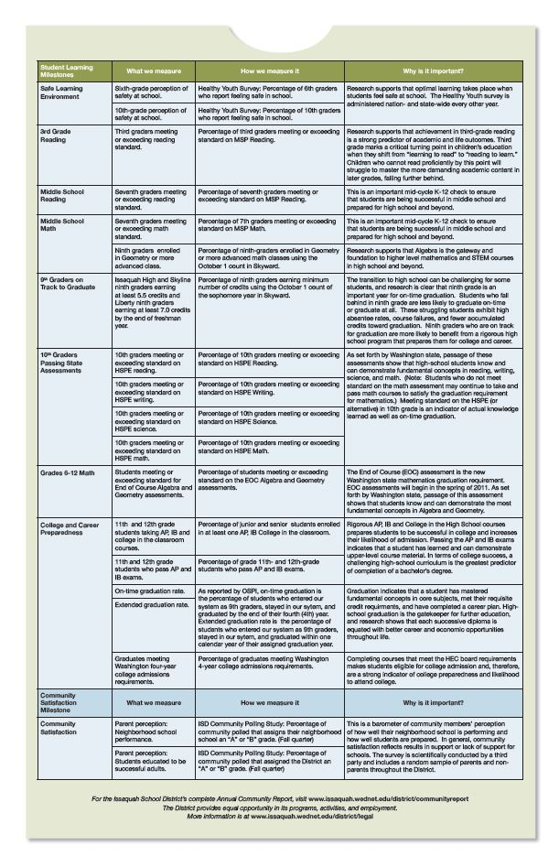
Key Performance Indicators

Slide 9
Evaluating the District on Clear and Focused Expectations

Slide 10
Benchmarks
Does regular communications from the board to staff and community reinforce its commitment to high levels of achievement for all students?
Does the board establish and follow a schedule for the timely review of the district plan?
Does the board ensure a high degree of coherence between the district’s plan and individual school improvement plans?
Does the board annually review district and school improvement plans?
Does the board publicly recognize the efforts of individuals and schools in improving student learning?

Slide 11
Setting high expectations for success
Vision and Mission Statements
Policy Governance Ends
Modeling Organizational Core Values

Slide 12
Timely and consistent review
District Strategic Plan
Continuous School Improvement Plans
Annual District and Board Goals

Slide 13
Evaluating the Superintendent on Clear and Focused Expectations

Slide 14
Benchmarks
Does the board establish a policy and process for routine evaluation of the superintendent?
Does the board have written performance expectations for the superintendent and communicate those to the community?
Does the board solicit appropriate data for the superintendent evaluation?
Does the board evaluation of the superintendent include a review of the superintendent’s professional development activities?
Does the board base the decisions about the superintendent’s contract on the objective evaluation of the superintendent’s achievement of performance expectations?

Slide 15
Policy and Procedure
What is the policy for evaluation?
Do you have a process for goal setting?
Is there an informal mid-year review?
How are the goals made explicit?
How are the performance expectations aligned with measureable outcomes?

Slide 16
The Contract
What is the process for contract extensions and salary increases?
Is objective evaluation criteria a basis for the negotiations?

Slide 17
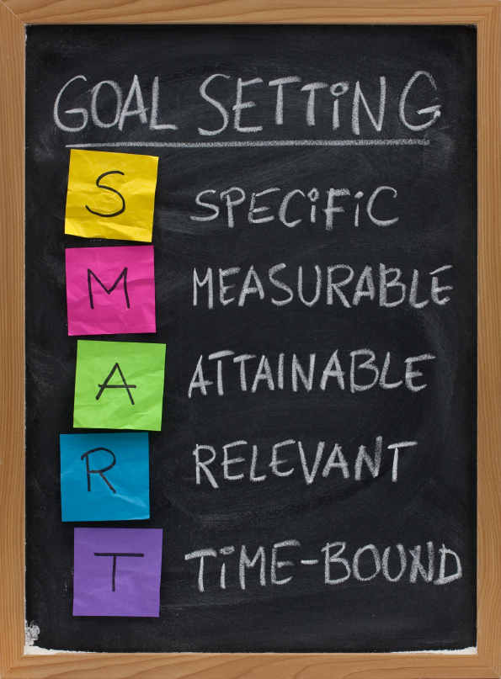

Slide 18
Using data effectively
Does the board include key stakeholders in Data Conversation on academic progress?
How often does your board discuss the meaning and implications of data-based and research-based decision making?

Slide 19
Measuring progress toward goals
How much of your board meeting time is spent on reviewing student achievement topics?
What is the process in your district for reviewing data related to the key performance indicators of the district’s goals?

Slide 20
Approval of criteria, tools & methods
What is the process for engaging your administration and instructional staff in conversations about assessment criteria?
Does your district have a common understanding and agreement around the purpose and use of formative and summative assessments?
How does your board become knowledgeable in valid and reliable assessments?

Slide 21
Adjusting resources for max effect
What is your board’s process for evaluating and adjusting resources during the budget cycle?
Does your board prioritize and reconcile budget requests with strategic goals and initiatives?

Slide 22
Questions?

Slide 23
Thank you.

Slide 24
Boneyard

Slide 25
Learning Outcomes
Affirm the importance of the board’s role in holding the district accountable for student learning expectations.
Review the leadership team's roles and responsibilities regarding accountability for student achievement.
Recognize the policy implications required for setting high expectations.
Understand how to use data to monitor and assess the achievement of all students
Identify and understand what types of data analysis should be used to monitor and evaluate the district's progress toward improving student achievement.

Slide 26
Learning Outcomes
Identify strategies and next steps to developing a district accountability plan.
Understand the interrelationship between the strategic planning, goal setting, and evaluation activities with student achievement.
Review how Standard 4‘s benchmarks and indicators can be used in superintendent and board evaluation.

Slide 27
Authenticity
Authentic assessment is aligned with the classroom objectives and reflects real-world applications.

Slide 28
Strategic acts of alignment
Random acts
Silo effect
Islands of Excellence
vs.
Aligned acts of improvement

Slide 29
Using Intelligent Data
Creating Cultures of Inquiry

Slide 30
Video Title
video
Name
Title
Group

