Slide 1
McCleary Compensation & Levy Briefing
MCC Proposal: SB 6109 SDC Proposal: SB 6103 & 6104 HDC Proposal: HB 2239
Rep. Chad Magendanz | 5th LD
4/23/2015
Notes:
The state school levy provides about a quarter of the money in the General Fund that the state spends on public schools. In addition, revenues from the sales tax, business and occupation tax, real estate excise tax, and other sources support public schools.
The state school levy as we know it today was enacted in 1975.
Prior to 1975, property owners paid a local regular school levy of $3.60 per $1,000. The local regular levy was replaced by the regular state levy and state aid was increased to replace the lost local revenue. Over the following few years, the state moved to fully fund basic education from the state General Fund.

Slide 2
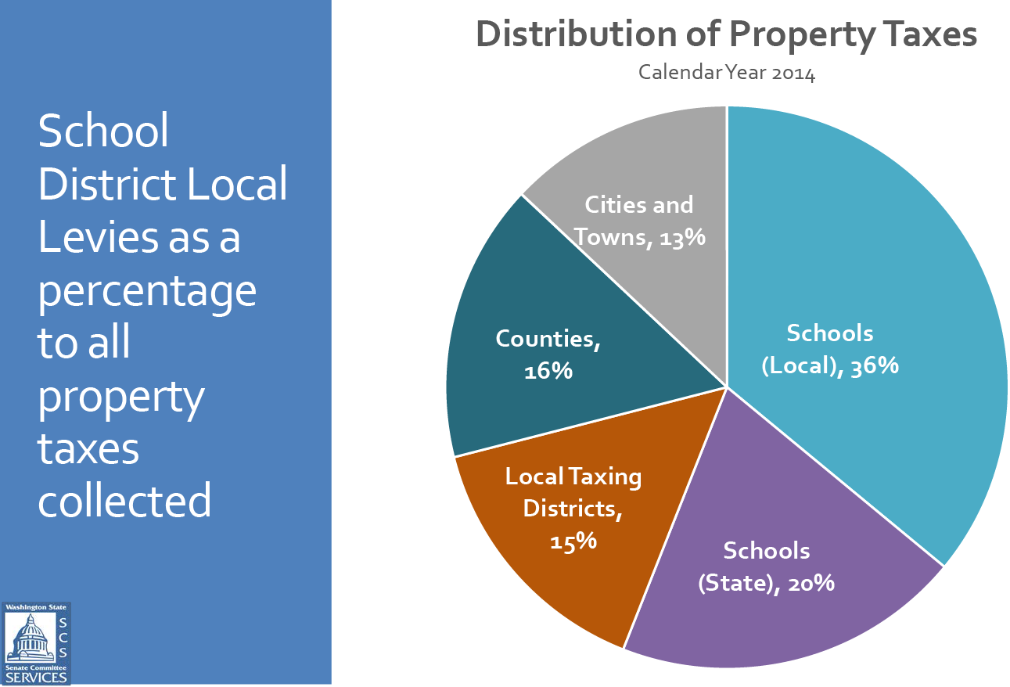

Slide 3
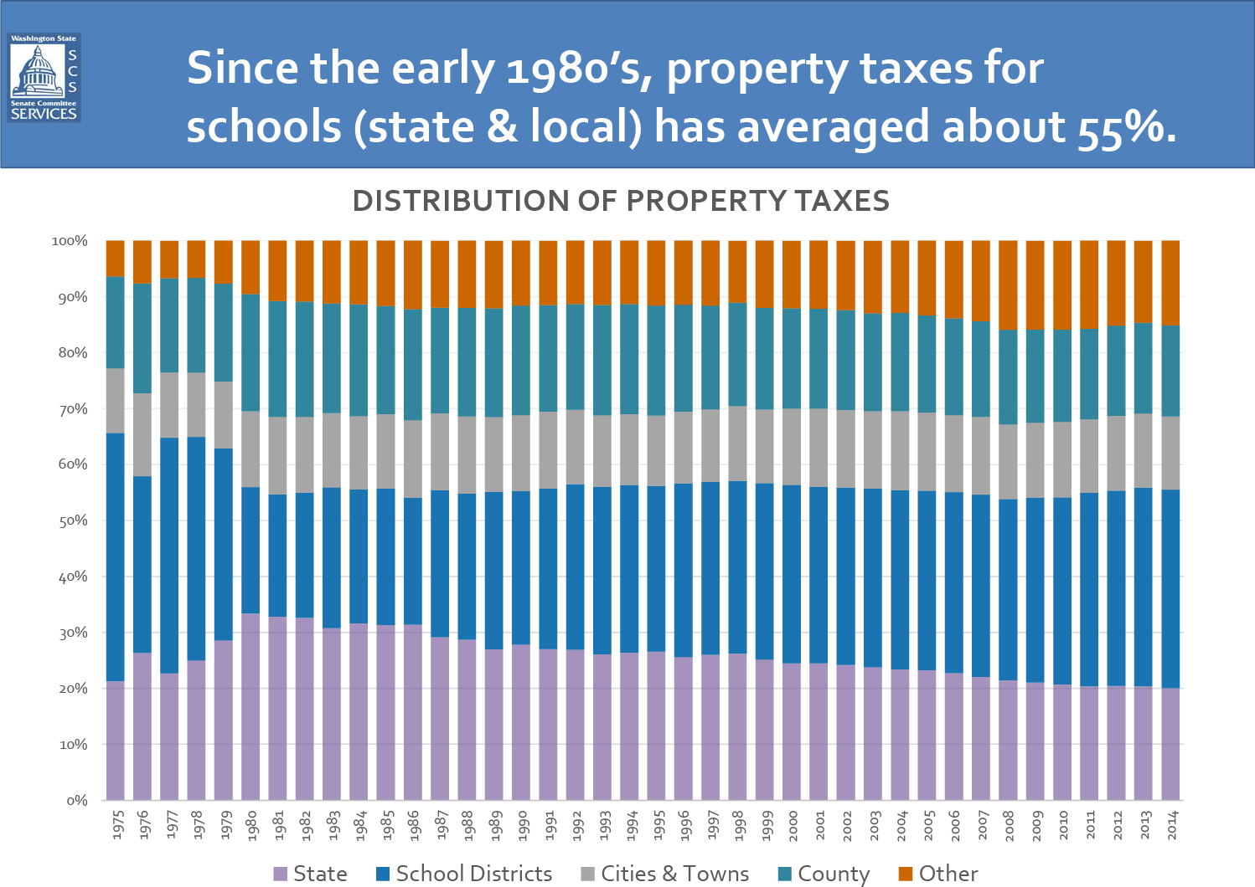

Slide 5
Notes:
Since the school year shown in this graph…you have increased the pupil transportation by $108M, MSOC by $280M, and staffing allocations by $316M per school year. = $704M each year

Slide 6
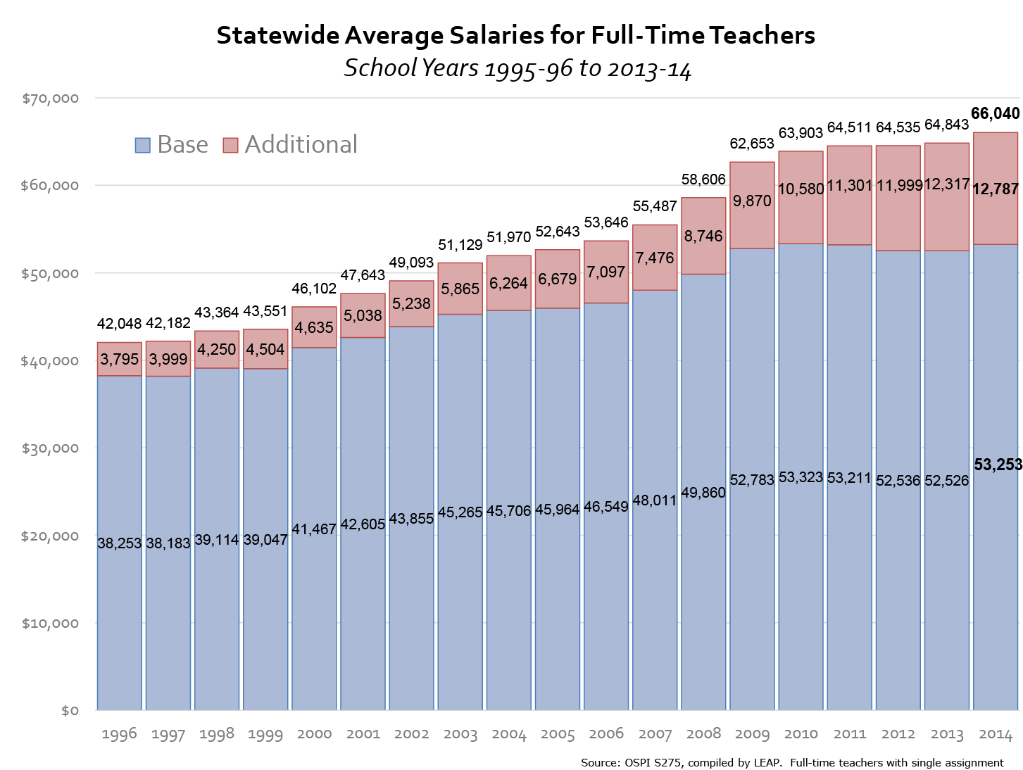

Slide 7
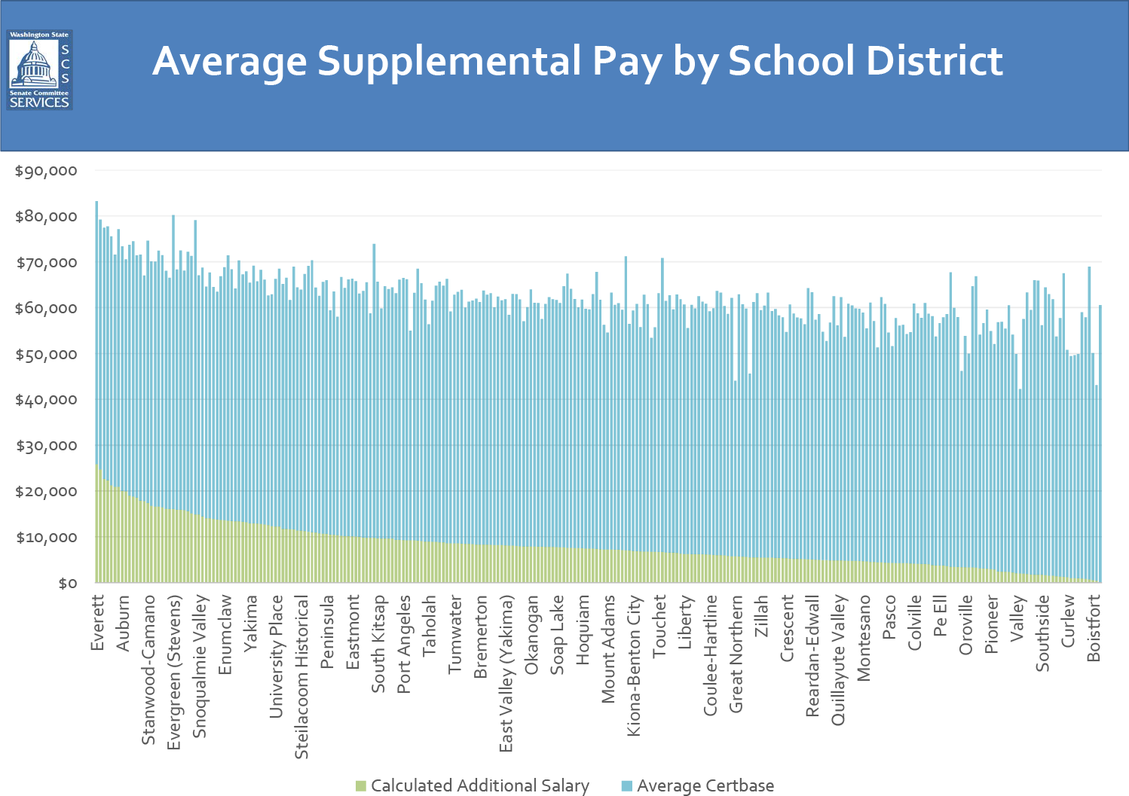

Slide 8
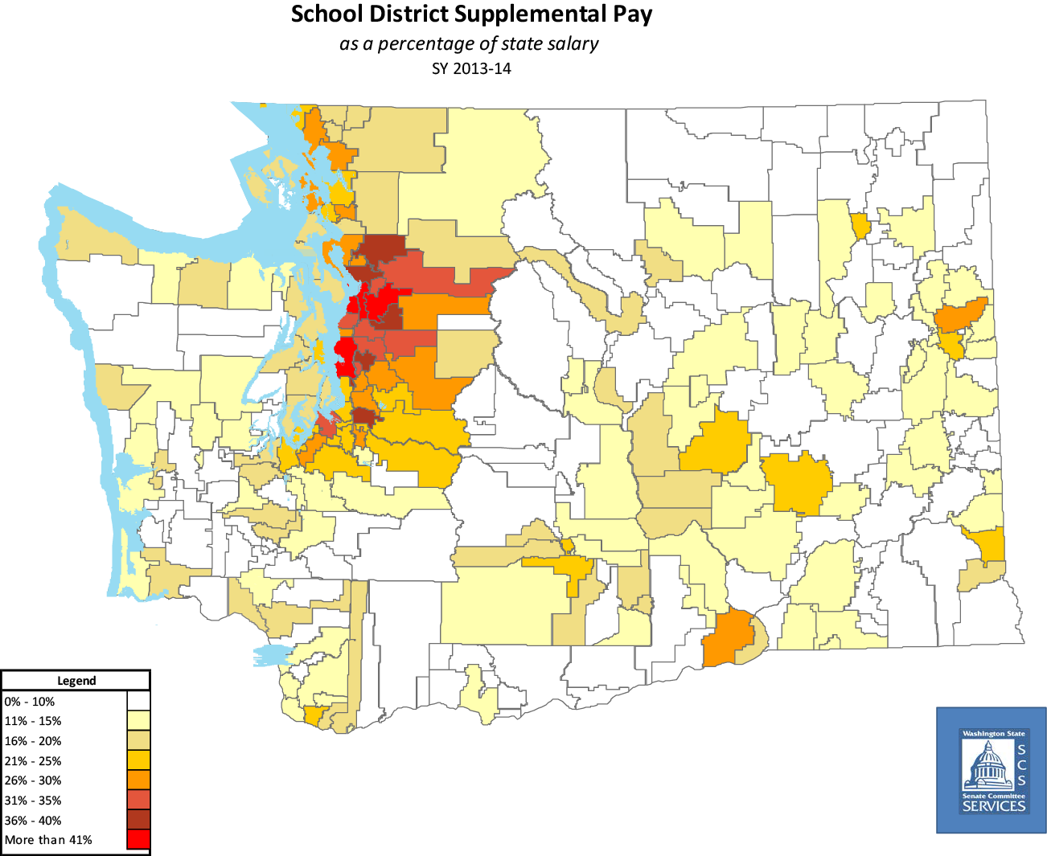

Slide 9
MCC Proposal (SB 6109)
Common Schools Levy Restoration offset by Local Levy Reductions
Shifts levy authority for basic education from local school districts to the state. Statewide revenue neutral, so no new taxes. This would particularly benefit property-poor areas with low assessed property values. Local levies still permitted for program enhancements and extracurricular activities, but limited to no more than $1.25/1000 at full implementation.
Changes the teacher salary grid to a grid similar to that recommended by the Compensation Technical Working Group. Creates a localization factor to adjust salaries using comparable wage data in different regions.
Statewide COLA as part of basic education, indexed to the Implicit Price Deflator. Salary differentiation based on certification, not seniority; master’s degrees only if relevant to instruction subject.
Full implementation in the 2018-19 school year.

Slide 10
SDC Proposal (SB 6103 & 6104)
New Capital Gains Tax offset by Local Levy Reductions
Imposes a new 7 percent tax on capital gains of $250,000 and above for individuals, $500,000 and above for couples. New capital gains tax would yield approximately $1.2 billion per biennium to offset the current local contributions to basic education.
Local M&O levies reduced and later limited. No changes to state property tax specified.
I-1351 is maintained, phased in on a delayed schedule, but is unfunded.
Modifies and implements the recommendations of the Compensation Technical Working Group.
Full implementation in the 2022-23 school year.
Capital gains tax would be much more volatile than the common school levy (property tax), requiring more discipline by the Legislature to control spending during years of economic growth so we can maintain services in recessionary periods.

Slide 11
HDC Proposal (HB 2239)
Kicking the Can Down the Road (PUNT!)
Creates a “Washington Education Funding Council,” made up of eight lawmakers and one representative each from the governor, treasurer and state superintendent. Would consider revenue proposals including a carbon tax.
Sets 2016 and 2017 deadlines for specific legislation to be enacted by the Legislature.
By 2017 the legislature must adopt a compensation plan including regionalization factor, and a funding mechanism to support that plan (levy reform, carbon tax, or other options as recommended by the council). New compensation system must be fully implemented by 2018-19 school year.
Full implementation 18-19 school year.
Just kicks the can down the road, doesn’t actually eliminate dependency on local levies for our program of basic education.

Slide 12
Estimated SB 6109 Impact by District
Includes LEA, but excludes HB 2776
District | Levy Rate | Rate Diff | District Impact | District Net
Seattle | $1.32 | +$1.43 | +$105M | -$97M
Tacoma | $4.39 | -$1.64 | -$2M | +$30M
Spokane | $4.52 | -$1.77 | -$32M | -$3M
Kent | $4.42 | -$1.56 | +$6M | +$34M
Puyallup | $4.06 | -$1.31 | +$12M | +$28M
Kennewick | $3.45 | -$0.70 | +$4M | +$9M
Issaquah | $2.16 | +$0.59 | +$19M | +$7M
Yakima | $2.91 | -$0.16 | +$0.6M | +$1.3M
Bellingham | $2.37 | +$0.38 | -$2.9M | -$7.7M
Wenatchee | $2.79 | -$0.04 | +$0.9M | +$1.0M
Walla Walla | $3.56 | -$0.81 | -$2M | +$0.5M

Slide 13
Thank you.

