Slide 1
Elections Security
What’s it take to secure our elections?
Chad Magendanz | CXO, Voter Science
5/20/2017

Slide 2
Would he mess with our elections?

Slide 3
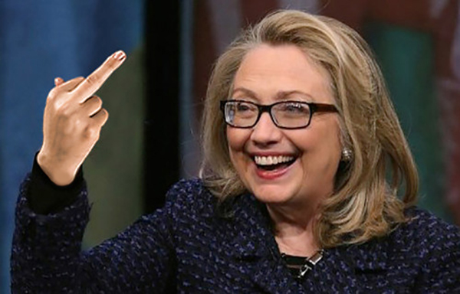
How about her?

Slide 4
Yeah, this guy definitely would.

Slide 5
But does this matter to me at the local level?
Elections Security

Slide 6
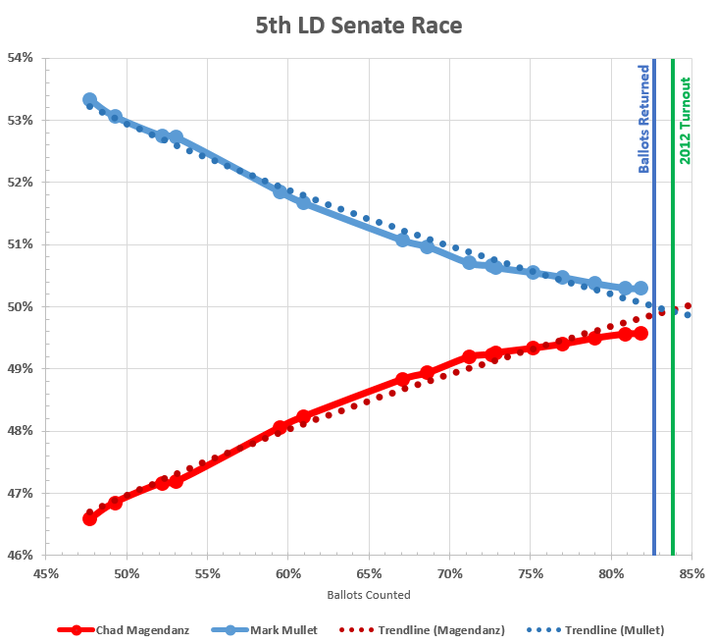
Notes:
In a presentation to the hacking convention Chaos Communication Congress (CCC) in December 2016, Bernhard and Halderman argued that in order to overcome the U.S.’s diverse, decentralized voting technologies, an attacker would need only determine (with help from pre-election assessments like Nate Silver’s) which states are likely to result in close votes, select two, then preordain an Electoral College victory by shifting those states’ votes by less than 1 percent of the total (which would dispel suspicion).

Slide 7
First…some context!
Elections Security

Slide 8
Ripped from the Headlines
Hacking of DNC and Hillary Clinton campaign emails
Repeated claims from Donald Trump of election “rigged” against him
Coordinated tampering (SQL Injection) attacks on voter registration databases in 20 states (at least 2 successfully)
DDoS and zero-day attacks in Ukraine’s 2014 parliamentary elections to fake election results
Outdated and unsupported electronic voting machines being decertified by states for their security issues
Notes:
The 19,000 leaked emails, which struck controversy over how the party played favorites in the party’s inner rivalries, stoked a rift between the Sanders and Clinton wings, and resulted in the resignation of Debbie Wasserman Schultz, the DNC chairwoman.

Slide 9
Vulnerabilities
Roughly 187,000 precincts across 13,000 jurisdictions
GEMS Fraction Magic - Fractional vote feature embedded in application which can be used to invisibly, yet radically, alter election outcomes by pre-setting desired vote percentages to redistribute votes
EVMs manufacturers consolidated to three companies: Dominion Voting Systems (Toronto), Election Systems & Software (Omaha), Hart InterCivic (Austin)
21.55% of votes cast in the 2016 elections had no paper trail!
Notes:
At one point, there were 19 voting machine companies listed in the Federal Election Commission Buyers Guide, but the guide is no longer available. Through a series of mergers, acquisitions, and business failures, the voting machine industry currently is dominated by the three companies. All three companies are privately held and do not disclose their revenue or profits.
Electronic voting machines, which replaced the older punch card system following the 2000 presidential election’s vote-counting debacle, are being shunned for their outdated and vulnerable technology. Most are more than a decade old and are running Windows XP, which is no longer supported by Microsoft. And they are being decertified by states for their security issues.
At least 28 states are using systems that were never certified by the EAC.
Among the goodies VITA found with the AVS WinVote system:
The wireless connection uses WEP (which we knew). What we didn’t know is that a few minutes of wireless monitoring showed that the encryption key is “abcde”, and that key is unchangeable.
The system hasn’t been patched since 2004 (which we knew). What we didn’t know is that the system is running a whole bunch of open ports with active services. The report specifically notes that ports 135/tcp, 139/tcp, 445/tcp, 3389/tcp, 6000/tcp and 16001/tcp are all running unpatched services. (Layman’s explanation: the voting machines aren’t just voting machines, they’re also servers happy to give you whatever files you ask for, and various other things, if only you ask. Think of them as an extra disk drive on the network, that just happens to hold all of the votes.) (Obdisclosure: In retrospect, I *probably* could have figured this out a few years ago when I had supervised access to a WinVote with a shell prompt, but I didn’t think of checking.)
The system has a weak set of controls – it’s easy to get to a DOS prompt (which we knew). What we didn’t know is that the administrator password seems to be hardwired to “admin”.
The database is a very obsolete version of Microsoft Access, and uses a very weak encryption key (which I knew a couple years ago, but didn’t want to disclose – the key is “shoup”, as also disclosed in the VITA report). What we didn’t know is that there are no controls on changing the database – if you copy the database to a separate machine, which is easy to do given the file services described above, edit the votes, and put it back, it’s happy as can be, and there are no controls to detect that the tampering occurred.
The USB ports and other physical connections are only marginally physically protected from tampering. What we didn’t know is that there’s no protections once you plug something into one of these ports. What this means is that someone with even a few minutes unsupervised with one of the machines could doubtless replace the software, modify results, etc. This is by far the hardest of the attacks that VITA identified, so it’s almost irrelevant given how severe the other problems are.
So how would someone use these vulnerabilities to change an election?
Take your laptop to a polling place, and sit outside in the parking lot.
Use a free sniffer to capture the traffic, and use that to figure out the WEP password (which VITA did for us).
Connect to the voting machine over WiFi.
If asked for a password, the administrator password is “admin” (VITA provided that).
Download the Microsoft Access database using Windows Explorer.
Use a free tool to extract the hardwired key (“shoup”), which VITA also did for us.
Use Microsoft Access to add, delete, or change any of the votes in the database.
Upload the modified copy of the Microsoft Access database back to the voting machine.
Wait for the election results to be published.
In a summation of the EVEREST findings, U-Penn team-leader Blaze (along with team-leaders from Penn State and WebWise Security) concluded, “There was a pervasive lack of quality in the implementation (coding and manufacturing) of these systems. Failures were present in almost every device and software module we investigated.”
Generally speaking, the e-voting machines these vendors (and other smaller manufacturers) produce fall into two categories: optical scanners, and Direct Recording Electronic (DRE) machines. Optical scanners may be small — such as those used in precincts to validate and accept hand-marked ballots — or they may be enormous, used on a county-wide scale to centrally count paper ballots (such as absentees). DREs, meanwhile, are usually touch-screen devices. Some are equipped with a printer that delivers a paper confirmation prior to finalize a voter’s choices (known as a “Voter-verified paper audit trail,” or VVPAT) — but others are not. As a result, some 21.55 percent of votes cast in the 2016 election did not leave any kind of paper trail, according to Verified Voting.
https://thinkprogress.org/how-easy-would-it-be-to-rig-the-next-election-819326cbbbd

Slide 10
Where can things go wrong?
Information Leaks
Bogus Voter Registration
Voter Suppression
Vote Tampering
Undermining Confidence in System
Notes:
Central Tabulator Manipulations
Other possible cyber-attacks can be lower level hacks, which do not directly affect candidates, campaigns or results, but can have a flooding effect if pulled off in time. Such attacks would include stealing candidates’ internal strategy documents, or messing with campaign schedules and deceiving voters about when polls are open.
Thanks to the internet, these types of attacks can be staged not only by local pranksters and vandalizers, but also by foreign hackers thousands of miles away. Imagine a compromised campaign Facebook account suddenly changing event locations and timings, misinforming thousands of participators and preventing them from attending the event. Or in another scenario, imagine a compromised campaign email account that starts sending profanity or badly-timed and deceiving content to mailing lists.
“On election day, DDoS is likely to be the most damaging attack scenario, as it can severely cripple the voting process by taking down crucial supporting services and infrastructures,” says Igal Zeifman, director of marketing at Imperva Incapsula, referring to the type of attack that would take down servers and machines by overloading them with remote requests. “Consider what would happen if the attack was used to take down the voting system itself or even one of the local election agencies. The result could be catastrophic.”
“To ‘hack’ a US presidential election, all you need to do is to obviously tamper with one county’s system, then leak that the tampering occurred,” Sullivan says. “Many people will rush to assume that all of the other typical issues that occur may also be the result of hacking — and thus, you’ll end up delegitimizing all of the results.” The outcome, Sullivan further explained, would be “a damaged winner who will be undermined in the international political arena.”

Slide 11
Any hope for the future?
Elections Security

Slide 12
Ballot Images
A new way to verify that results are true – CROWDSOURCING!
This is already available in most systems
Laws are already on the books to authorize you to do this
Costs almost nothing and enables almost everyone to authenticate computerized voting system results
All that remains is cooperation (or court-ordered coercion) of public agencies to force them to honor your rights
Notes:
THE BRAKEY METHOD
Preserve and make public the “ballot images” — Modern voting systems take a picture of every ballot, called a “ballot image.”
Peg the ballot image to the actual ballot using a unique ID number (not connected to any voter identifier in any way).
Make sure ballots are a public record so that any person can arrange to inspect the actual ballots at any time.
Ballot images can be released electronically, either upon request or — better — by placing them on the Web, allowing any person to examine pictures of any or all ballots. These electronic images can be authenticated by any person by checking any ballot, which must contain same unique ID number.
What casts well-deserved doubt on paperless DREs is their lack of physical evidence of tampering. In theory, this should make optical-scan voting safer, since even if attackers are able to change digital results of scanning, the paper record would still tell the truth.
However, as Bernhard and Halderman have pointed out, a paper trail only matters if it’s actually examined as part of the regular election process. In the U.S., it almost never has been. The 2016 election cycle endured multiple instances of hacking from attackers based in a hostile nation-state, and it resulted in a surprising outcome in which a candidate who polled as significantly less likely to win nonetheless became president — yet few if any states looked at any paper ballots created by computers to determine if there was evidence of attempts to breach their systems.
“Most states never look at the paper,” Bernhard said in their CCC presentation. “You have a great way to defend against an attack, but you never use it.” “If even in 2016 we’re not going to look at any of the paper,” Halderman added, “Well, it might as well not be there.”

Slide 13
Blockchain
the immutable, distributed ledger that powers Bitcoin
Notes:
Many blockchains currently exist, and a number of these could serve as possible platforms for voting services. Follow My Vote is a Virginia-based startup hoping to move people toward blockchain-based voting. The firm’s platform, based on the BitShares blockchain, will enable voters to cast their votes online using a unique voter ID and their private key; they will use webcams and government-issued IDs to authenticate themselves. The system uses cryptography and end-to-end encryption to keep votes anonymous and immutable. A publicly available ledger will make it viable for everyone to directly follow the results as the election unfolds, and at any stage of the voting process, voters will be able to verify their own votes and make sure they haven’t been modified.
Follow My Vote will be testing its platform in a mock online election that will run in parallel with the U.S. presidential election. There’s also NYC-based Blockchain Technologies Corp., which is taking a hybrid approach of a blockchain-powered voting system coupled with paper ballots that use QR codes to ensure each vote is only cast once.

Slide 14
Blockchain
the immutable, distributed ledger that powers Bitcoin

Slide 15
AI Auditing
Should we hand over control of our elections to Skynet?
Develop a machine learning service that will monitor network activity and report to human experts who will filter out the noise
The man and machine combination will help network admins detect and stop breaches before they become damaging.
This is the sort of service that many organizations such as banks are now moving to adopt. Government can’t afford to lag behind.

Slide 16
Protecting the campaign
Elections Security

Slide 17
Is your data secure?
Because of their short lifespan, campaigns are for the most part woefully weak in securing their data against cyber attacks.
The focus is rarely on cybersecurity, there’s little or no federal and local oversight on security practices.
Information stored by campaigns, which includes donor information, internal emails, opposition research and vulnerability studies, is quite sensitive, and makes them attractive targets.
Notes:
We tend to talk about security issues while the campaigns are running, and forget about them after the elections are done.

Slide 18
Move to the cloud!
Don’t spend a hefty part of your limited budget buying equipment and software to secure a campaign that will last mere months.
Cloud-based security such as web application firewalls (WAF) and DDoS protection services do not require any upfront investments and can be paid for in an on-demand model.
Has ability to scale based on the changing needs of your campaign.
Notes:
We tend to talk about security issues while the campaigns are running, and forget about them after the elections are done.

Slide 19
Resources
Election Assistance Commission (EAC.gov)
National Institute of Standards & Technology (NIST.gov)
OpenElectionData.net
BlackBoxVoting.org
FollowMyVote.com
VoteWatcher.com
Notes:
Committee chairman Rep. Gregg Harper (R-MS) released a statement calling the Election Assistance Commission (EAC) “an agency that has outlived its usefulness, mismanaged its resources, and cost taxpayers millions. […] Bottom line, the agency does not administer elections and the time to eliminate the EAC has come.”

Slide 20
Questions?

